Slide 1
Docker all the things!
Paul Yuknewicz
@paulyuki99

Slide 2
Demo
Containers in Visual Studio 2019

Slide 3
Leverage the Ecosystem Tools for containers in Visual Studio 2019
.NET Core, .NET Framework
ASP.NET, WCF, Console
Linux, Windows
Alpine (*NEW), Debian, and Ubuntu images
Single Dockerfile, Kubernetes, Docker Compose

Slide 4
Best in class debugger Tools for containers in Visual Studio 2019
Full fidelity debugging inside the running container
Rapid debugger start times
Debug Kubernetes in the cloud
Test and Debug safely in a team environment using Azure Dev Spaces

Slide 5
Flexible: where you want, when you want Tools for containers in Visual Studio 2019
Containerize single ASP.NET and console apps
Add orchestration with Kubernetes or Docker Compose
Publish to many targets: App Service, Azure Container Registry, Azure Dev Spaces & AKS, DockerHub, custom..
Toggle seamlessly between native IIS or console, Docker, Compose, or Kubernetes/AKS runtime environments
Multi-stage build better enables release pipeline

Slide 6
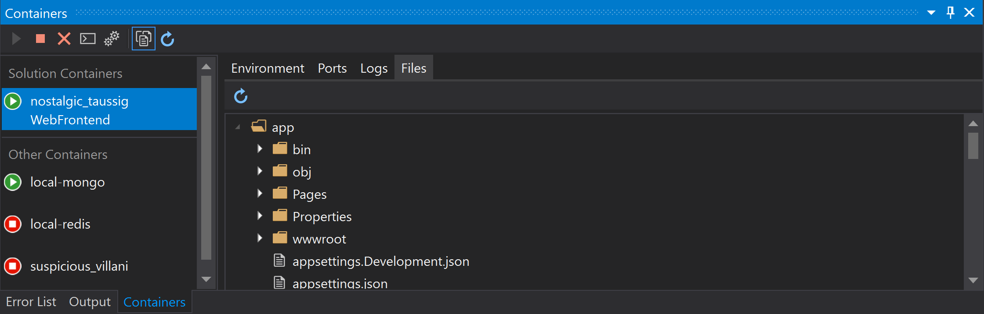
New Visual Studio tools for Docker Containers
Container window
Inspect environment variables, ports, files!, console shell into the container, stream logs
Makes testing and debugging easier
VS Extension today: https://marketplace.visualstudio.com/items?itemName=ms-azuretools.vs-containers-tools-extensions
ETA is Visual Studio 2019 16.4 in box

Slide 7
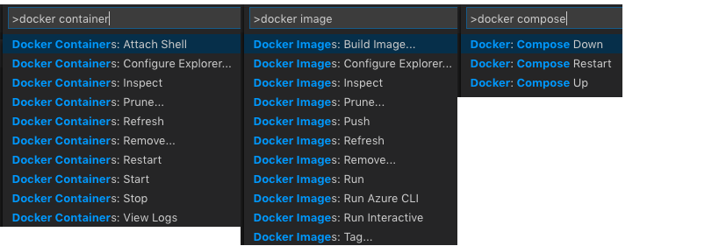
New Visual Studio Code tools for Docker Containers
Command palette for adding docker support and pushing to ACR
Inspect environment variables, ports, and files; remote shell
New: build Dockerfiles for single containers and run easily
But still Compose using Add Orchestration

Slide 8
Kubernetes Tools
Helps DevOps and Devs build distributed orchestrated apps
Scaffold and edit common assets: Yaml manifests, Helm
Azure Dev Spaces to make building, testing and debugging services in large cloud distributed apps easier
Visual Studio: https://marketplace.visualstudio.com/items?itemName=ms-azuretools.vs-tools-for-kubernetes
Visual Studio Code: https://marketplace.visualstudio.com/items?itemName=ms-kubernetes-tools.vscode-kubernetes-tools

Slide 9
Multi-Stage Build Tools for containers in Visual Studio 2019
Define pipeline stages like build, publish, test and final
Create leaner images
Integrate better with your DevOps pipeline

Slide 10
Demo
Paul Yuknewicz

Slide 11
Summary
Install Visual Studio 2019 with Web, Azure or Container workloads
Build and debug containers in VS
Learn more: https://docs.microsoft.com/en-us/visualstudio/containers

